Slide 1

Machine learning for music
A whirlwind tour
Jørgen Aarmo Lund
UiT Machine Learning Group, DIPS AS

Slide 2
Preparation
If you want to test the code during the break:
Clone https://github.com/jaalu/ml-for-music

Slide 3
About me
Industry PhD at UiT Machine Learning Group for DIPS AS
DIPS AS develops e-health solutions
Presentation on deidentification of Norwegian text at NLDL 2024
Hobby: electronic music
https://soundcloud.com/strangecasts
Contemporary Electronic Music from Norway 2023 at Bandcamp (soon Spotify)
https://unts-untsplinksandplonks.bandcamp.com/album/contemporary-electronic-music-from-norway-2023-vol-a

Slide 4
Why is music interesting for ML?
Fairly low risk
But overlaps with important signal processing challenges
Large permissively licensed datasets available
Latency not a problem in many applications
But very important in some applications

Slide 5
Why music specifically?
Can’t we treat it like any other sound?

Slide 6
What are the challenges?
We are very sensitive to music that is out of tune or off-beat
https://www.youtube.com/embed/67q-hXkZxE8
In a generative setting, wrong notes are easier to notice than wrong pixels or wrong words
Music theory is only descriptive
Not a recipe for creating good music!

Slide 7
What are the challenges?
Music is sound with
Overlapping instruments with individual melodies and timbres
Timbre: sound characteristics apart from pitch and volume
Short-term structure: rhythm, intensity
Long-term structure: chord progressions, song structure

Slide 8
Applications for ML
Composition
Completing progressions, melodies
Sound design
Differentiable synthesis, generative modelling, voice synthesis
Sound processing
Source separation, noise removal, pitch correction
Music analysis
Tempo estimation, transcription, sound similarity
Sound effects
Amplifier, effect modelling
Song generation
Text-to-music, style transfer
And more!

Slide 9
Composition
Before we go into signal processing, let’s put together a melody!
Audible frequencies divided into octaves
Each octave is divided into 12 notes: A, A#, B, C… G
Music usually follows a key signature and a progression
Certain notes make more sense at certain times
We can treat this as a probability distribution, and predicting the next note as a sequential prediction problem

Slide 10
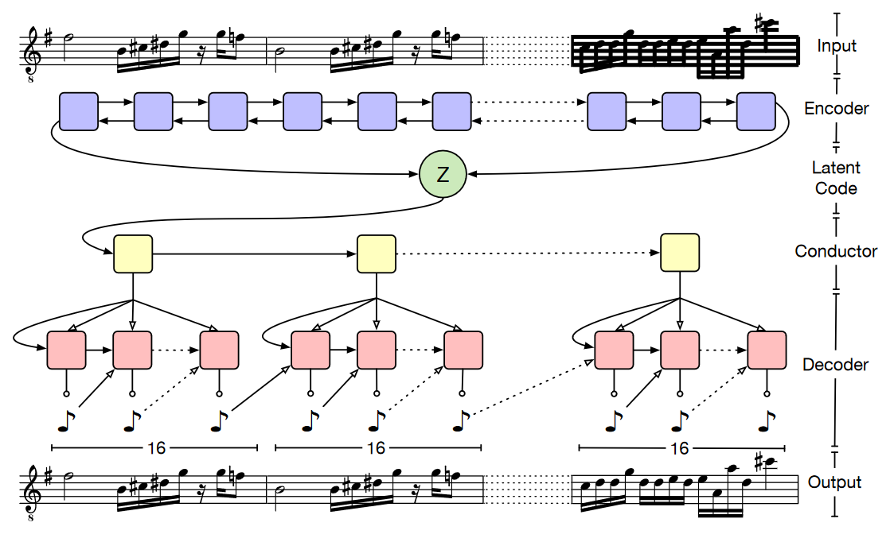
Composition with MusicVAE
2018: MusicVAE by Google Magenta
Hierarchical variational autoencoder for musical arrangements
Collected 1.5 million MIDI arrangements
Model the melodies as sequences of 16th notes and rests, leading to 32-step sequences of 130 possible tokens
Uses a bidirectional LSTM as an encoder
To avoid posterior collapse, use a hierarchical RNN as a decoder
A “conductor” network produces embeddings for note subsequences (in this case, one bar of 16 notes)
Bottom-level RNN decoder then autoregressively generates sequences of distributions of tokens/notes for each subsequence
Each decoder step concatenates the current conductor embedding with the previous output to get the next input

Slide 11
Composition with MusicVAE
MusicVAE available through the Magenta Studio toolkit and through the Javascript library Magenta.js
Interactive playground at
https://hello-magenta.glitch.me/
Also demos at
https://magenta.tensorflow.org/demos
See also: OpenAI’s MuseNet https://openai.com/research/musenet
Builds on Sparse Transformer
Prepends composer and instrumentation tokens to arrangements to allow conditioning on style

Slide 12
Testing MusicVAE

Slide 13
How do we represent sound?

Slide 14
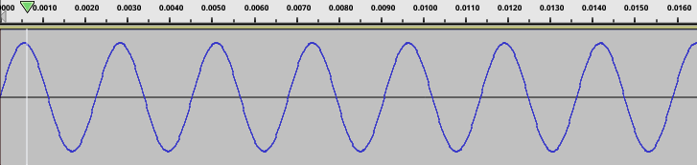
How do we represent sound?
Sound is fundamentally variation in pressure
Microphones have membranes which pick up this pressure
By sampling the position of the membrane at regular intervals, we can reproduce the sound:
The audible frequency range is 20 Hz to 20 kHz
To account for imperfect filters, sound usually recorded at 44.1 kHz or 48 kHz

Slide 15
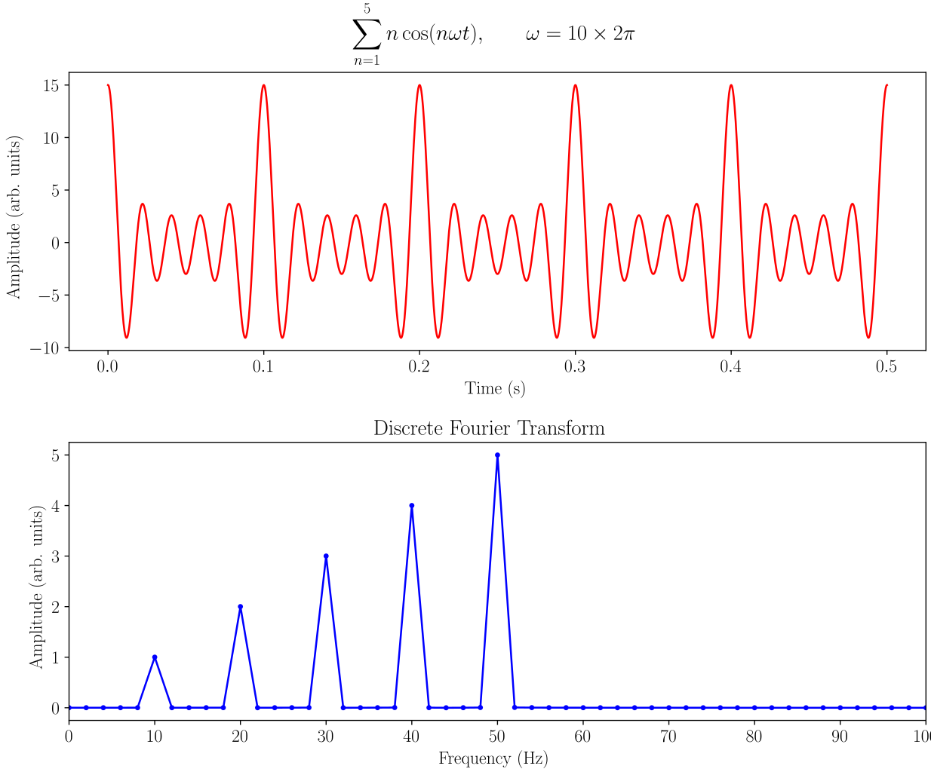
How do we represent sound?
Time-domain representation is nice for looking at intensity and timbre, but makes it hard to work with pitch, especially with multiple instruments
We can use the (discrete) Fourier transform to examine the sound in the frequency domain:
Illustration: AkanoToE

Slide 16
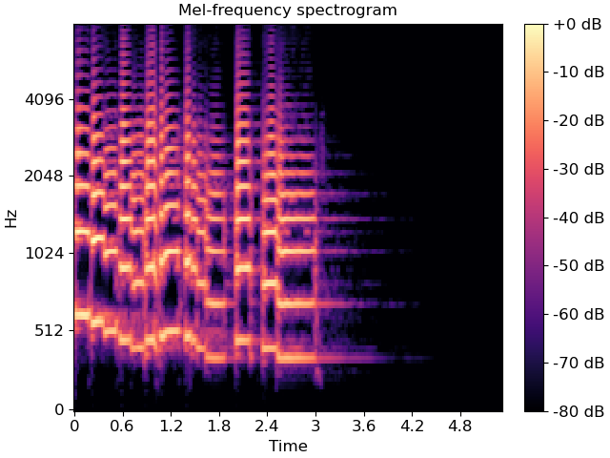
How do we represent sound?
We want to work with and eventually generate music, so we also want a representation which can work with frequencies over time
We can take the short-time Fourier transform over successive windows of the signal to get a spectrogram of the frequencies over time
Some networks (e.g. MelGAN, Lyra) build on mel-spectrograms, which use the logarithmic mel scale to represent pitches
Can restrict ourselves to a chromagram which only looks at musical pitches
Illustration: Librosa documentation

Slide 17
How do we model sound?
Recall that we usually record sound at 44.1 kHz
One second of mono sound = 44100 samples
Three minutes of stereo sound = 15,876,000 samples
Can we work with the time-domain waveform as-is?

Slide 18
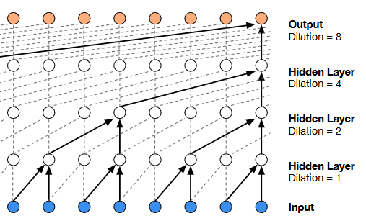

WaveNet
Google, 2016: Deep neural net for modelling raw waveforms
Goal: speech synthesis
Model the joint probability of a waveform $x=\left\{x_{1}, …, x_{T}\right\}$ as
$$p\left(x\right)=\prod_{t=1}^{T}{p(x_{t}|x_{1},…, x_{t−1})}$$
Key component: dilated causal convolution layers
Dilation: skip input values stepwise (stride “inside” the convolution)
Output dimension remains the same
Causal convolution: only consider current and past samples
Allows autoregressive generation without recurrent connections
Like PixelCNN, use residual connections and gated activations after convolution layers:
$z=\tanh\left(W_{f,k}∗x\right) ⊙ σ (W_{g,k} ∗x)$ where W is learnable - f acts as a filter and g as a gate
Illustration: Google, 2016

Slide 19

WaveNet
WaveNets evaluated on speech recognition, generation
Also tried modelling sounds from YouTube piano dataset
Found that it can also model piano music:
https://deepmind.google/discover/blog/wavenet-a-generative-model-for-raw-audio/
Nice to listen to, but:
Easily loses coherence
Can we evaluate it quantitatively?

Slide 20
Modelling guitar effects with WaveNet
We can also condition WaveNets on other data, including other waveforms!
E.g. linguistic features for text-to-speech
Guitar effects and amplifiers rely on physical characteristics of components
E.g. tube amplifiers, spring reverbs
Traditional white-box modelling is time-consuming
Instead, use a WaveNet to model the amplifier response[3]

Slide 21
PedalNet demo (and time to get snacks)

Slide 22
Sound processing - source separation
We have a mixed track – with guitar, drums, and vocals – and would like to extract the individual tracks
Making karaoke tracks, practicing guitar parts, remixing
Is this possible?
“No, it’s an underdetermined problem”
…but we can pick out instruments, and can make some prior assumptions
“Yes, just put some band pass filters on”
…but instruments have overtones and overlapping frequency bands
Good candidate for ML-based solutions

Slide 23
Source separation with DeMUCS
Rouard, Massa and Défossez, 2022: “Hybrid Transformers for Music Source Separation”
Builds on earlier ”Hybrid Spectrogram and Waveform Source Separation”
Does it matter whether we use the waveform or the spectrogram as our input representation?
Should not matter in theory, since we can infer one from the other
But in practice, data is limited, and some information easier to retrieve from one over the other
DeMUCS uses two U-Nets per source: one in the time domain, using temporal convolutions, and one over the spectrogram, using convolutions over the frequency axis
U-Nets connected in the middle by shared cross-domain Transformer encoder, connected to separate decoders
Final output from spectrogram decoder transformed with the inverse STFT, then summed with the output from the waveform decoder
Also uses:
Sparse attention to train with longer audio windows (12 seconds)

Slide 24
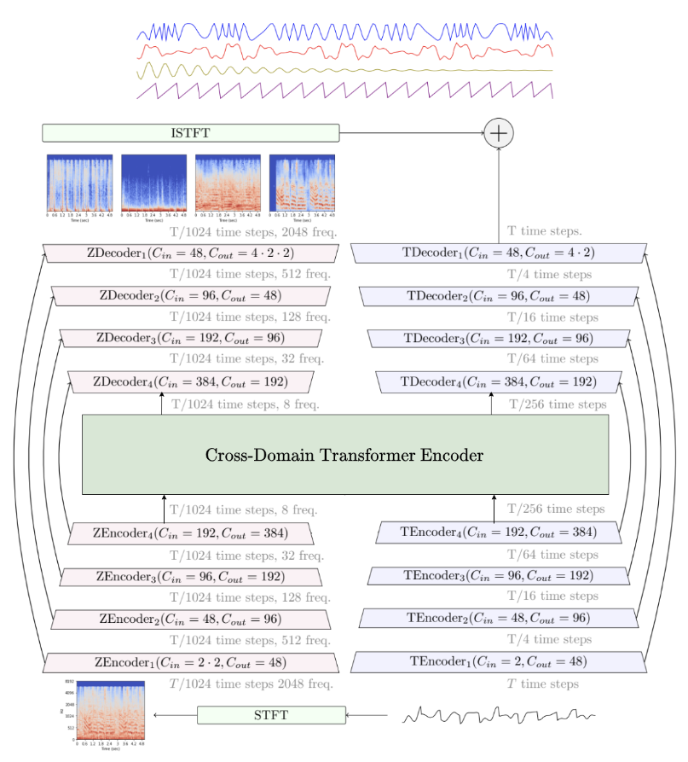

Slide 25
DeMUCS demo

Slide 26
Song generation
Goal: from a text description, generate a stylistically fitting song
2020: OpenAI Jukebox
“A neural net that generates music, including rudimentary singing, as raw audio in a variety of genres and artist styles.”
Several different approaches since: [7]
Riffusion (2022): Use Stable Diffusion to construct a spectrogram
Mousai (2023): cascading diffusion model

Slide 27
Song generation with MusicGen
J. Copet et al., 2023: “Simple and Controllable Music Generation” [6]
Uses the EnCodec [5] neural audio codec to work with music as discrete tokens
Convolutional autoencoder with a quantized latent space: a codebook maps latent representations to a set of discrete codes
Residual vector quantization: set up a new quantizer to code the quantization error from the previous layer
Uses multiple codebooks to allow generating tokens in parallel
Single-stage autoregressive Transformer model
Input tokens are given to a transformer with L layers, each with a causal self-attention and a cross-attention block
Cross-attention block is used to introduce a conditioning signal
Final output is the next token (which we can then decode to audio)

Slide 28
Song generation with MusicGen
Conditioning on text
To generate music from a text description, we can use a text embedding as the conditioning signal
Tested the T5 language model, FLAN-T5 and CLAP text-audio encoder
Conditioning on a melody
Can likewise use audio as the conditioning signal to guide the output
Embedding the whole spectro-/chromagram as a conditioning signal leads the model to reconstruct the original signal instead, so authors introduce a bottleneck on time and pitch bin

Slide 29
MusicGen demo

Slide 30
Ethics
Ongoing discussions
How does this affect musicians?
What constitutes transformative use?
Parallels to discussions about sampling
Late 80s: samplers allowed remixing drum patterns, sounds from other songs
The Winstons’ “Amen Break” used in 6000+ songs
Without royalties
Permissively licensed datasets
FMA, LoC Citizen DJ

Slide 31
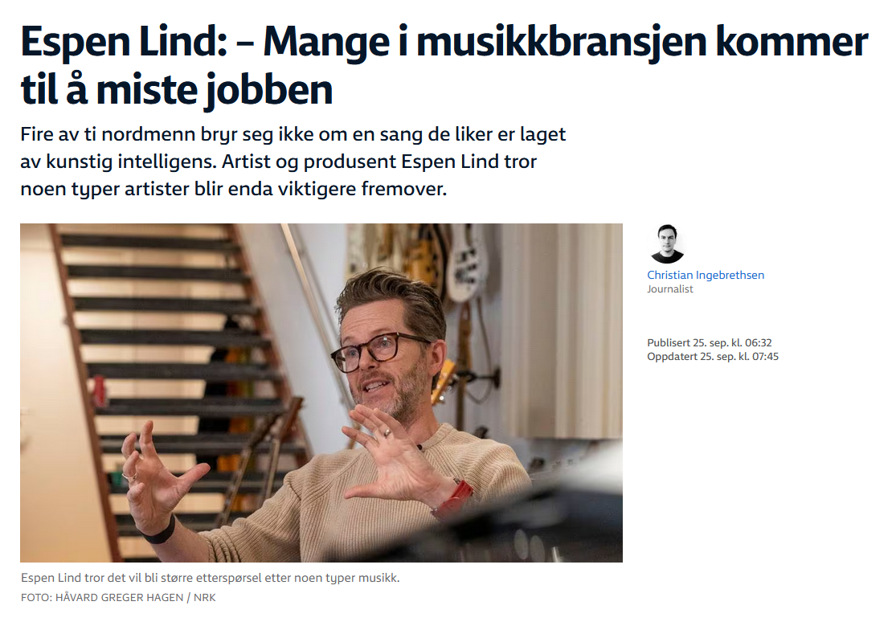

Slide 32
News
AI-assisted restoration recovered The Beatles’ “Now and Then”
Neural DSP: Commercial ML-powered amplifier simulators
Google Lyria: generated soundtracks for YouTube videos
”Dream Track users can simply enter a topic and choose an artist from the carousel to generate a 30 second soundtrack for their Short. [Lyria] simultaneously generates the lyrics, backing track, and AI-generated voice in the style of the participating artist selected.”
Ableton Live: similarity search for samples

Slide 33
Conclusion
As with text and images, generative modelling of music is cool and rapidly improving, but not the only application for ML!
Development from hand-crafted features to CNNs/RNNs to U-Net, Transformer-based methods
Definition of transformative use for generative music models still being settled

Slide 34
Questions, discussion and snacks

Slide 35
References
[1] A. Roberts, J. Engel, C. Raffel, C. Hawthorne, and D. Eck, “A Hierarchical Latent Vector Model for Learning Long-Term Structure in Music,” arXiv, arXiv:1803.05428, Nov. 2019. doi: 10.48550/arXiv.1803.05428.
[2] A. van den Oord et al., “WaveNet: A Generative Model for Raw Audio.” arXiv, Sep. 19, 2016. Accessed: Dec. 13, 2023. [Online]. Available: http://arxiv.org/abs/1609.03499
[3] A. Wright, E.-P. Damskägg, L. Juvela, and V. Välimäki, “Real-Time Guitar Amplifier Emulation with Deep Learning,” Applied Sciences, vol. 10, no. 3, Art. no. 3, Jan. 2020, doi: 10.3390/app10030766.
[4] S. Rouard, F. Massa, and A. Défossez, “Hybrid Transformers for Music Source Separation,” arXiv, arXiv:2211.08553, Nov. 2022. doi: 10.48550/arXiv.2211.08553.
[5] A. Défossez, J. Copet, G. Synnaeve, and Y. Adi, “High Fidelity Neural Audio Compression,” arXiv, arXiv:2210.13438, Oct. 2022. doi: 10.48550/arXiv.2210.13438.
[6] J. Copet et al., “Simple and Controllable Music Generation,” arXiv, arXiv:2306.05284, Nov. 2023. doi: 10.48550/arXiv.2306.05284.
[7] Y. Zhu, J. Baca, B. Rekabdar, and R. Rawassizadeh, “A Survey of AI Music Generation Tools and Models,” arXiv, arXiv:2308.12982, Aug. 2023. doi: 10.48550/arXiv.2308.12982.

